Slide 1
Serious Games and AI
Intro to Data Analysis
Summer 2021
Notes:
1
1
Check distro statement before using:
DISTRIBUTION STATEMENT A. Approved for pubic release: distribution is unlimited.
This material is based upon work supported under Air Force Contract No. FA8721-05-C-0002 and/or FA8702-15-D-0001. Any opinions, findings, conclusions or recommendations expressed in this material are those of the author(s) and do not necessarily reflect the views of the U.S. Air Force.
© 2021 Massachusetts Institute of Technology.
Delivered to the U.S. Government with Unlimited Rights, as defined in DFARS Part 252.227-7013 or 7014 (Feb 2014). Notwithstanding any copyright notice, U.S. Government rights in this work are defined by DFARS 252.227-7013 or DFARS 252.227-7014 as detailed above. Use of this work other than as specifically authorized by the U.S. Government may violate any copyrights that exist in this work.

Slide 2
Overview
Data Requirements Specification
Data Collection
Data Processing and Cleaning
Data Analysis
Data Presentation and Visualization
Notes:
Materials from:
https://www.tutorialspoint.com/excel_data_analysis/data_analysis_process.htm#:~:text=Data%20Analysis%20is%20a%20process,of%20discovering%20the%20required%20information.&text=Data%20visualization%20is%20at%20times,Data%20Analysis%20mean%20the%20same.
https://www.bigskyassociates.com/blog/bid/372186/The-Data-Analysis-Process-5-Steps-To-Better-Decision-Making

Slide 3
Data Requirements Specification
Define research question
How do we get these?
Scale / Scope?
Hypothesis
Research based proposed explanation
No assumption of truth
Identify what data you need to collect
How do you get data to support or refute your hypothesis
Serious games are a tool in a much larger tool box

Slide 4
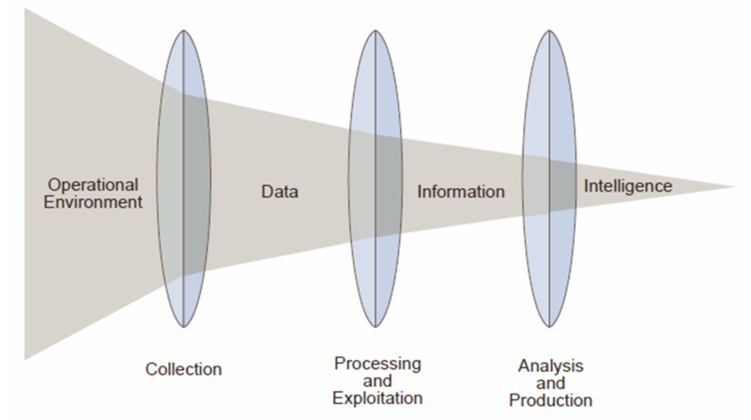
Data Requirements Specification
Notes:
https://en.wikipedia.org/wiki/File:Relationship_of_data,_information_and_intelligence.png

Slide 5
Data Collection
Set clear measurement priorities
Plan ahead
Focus on the most critical data
Put controls in place to ensure data quality
Put controls in place to bolster modeling assumptions
Normality, independence, etc…
Decide what to measure
Key factors / metrics / baselines
Instrumentation
Decide how to measure it
What are the best tools to use? Should we even use games?
Checking data quality

Slide 6
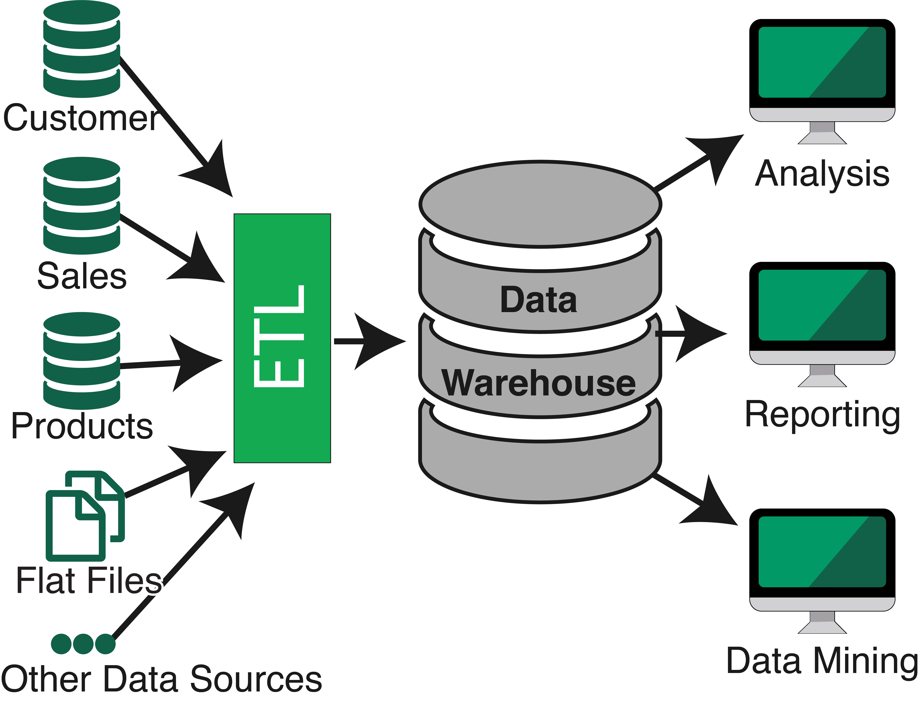
Data Processing
Data Exploration
Learn about the data
This will help inform data processing / cleaning
Transform data into workable form
ETL (Extract, Transform, Load)
Combine multiple data sets
Organization
Format data
Archive / Publish data
Reproducibility
Notes:
https://www.mongodb.com/blog/post/reducing-the-need-for-etl-with-mongodb-charts

Slide 7
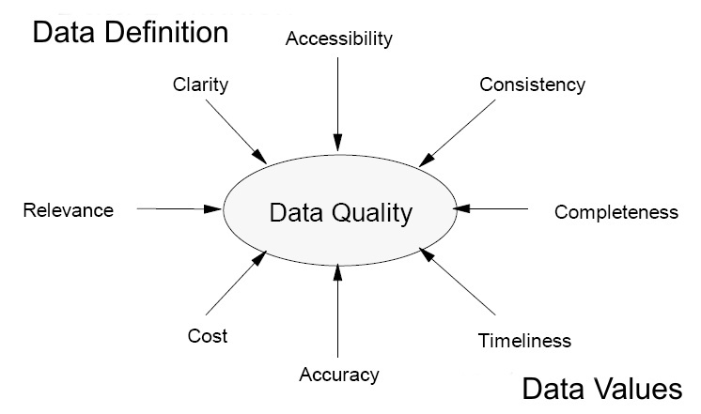
Data Cleaning
Data Deduplication
Data Standardization
Data Normalization
Data Transformation
Data Quality
Missing Values
Sampling / Balancing
Notes:
https://datasilk.com/data-cleansing/

Slide 8
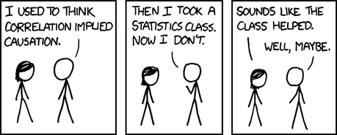
Data Analysis
https://xkcd.com/552/

Slide 9
Data Analysis
Clean data can be used in ML and statistical algorithms to provide insight into the acceptance or rejection of your hypothesis
Basic examples covered in the Data Analysis using Python lecture:
Summary statistics
ML (Classification, Clustering, PCA)
Regression
Statistical Testing (Normality, Stationarity, Difference of Means)
Correlation Analysis (Pearson, Correlation matrix)
These are just an exposure of myriad analysis techniques
How to decide which ones to use?

Slide 10
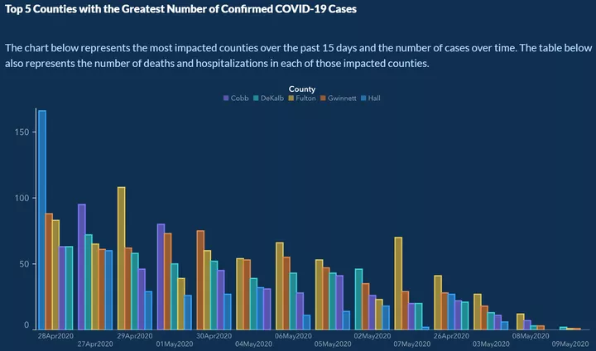
Data Presentation and Visualization
Interpretation
Clarity
Ethics
Responsibility
Lies, damned lies, and statistics
Limitations
Be clear and up front
Stick to your guns
Be critical and skeptical!
Notes:
https://www.businessinsider.com/graph-shows-georgia-bungling-coronavirus-data-2020-5

Slide 11
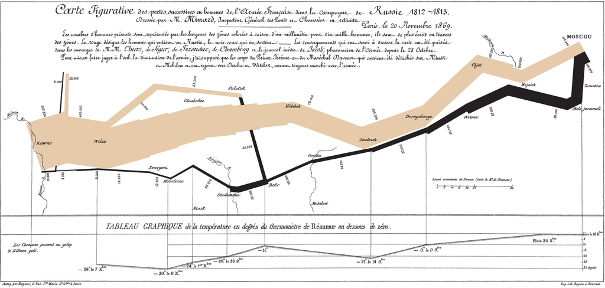
Data Presentation and Visualization
Techniques highlighted in Data Analysis using Python lecture for exposure
Histograms
Box plot
Scatter plot
Line plot
Networks / Graphs
Images
Notes:
https://en.wikipedia.org/wiki/Edward_Tufte
https://en.wikipedia.org/wiki/Edward_Tufte#/media/File:Minard.png

Slide 12


